Slide 1

Impulse Excitation
Technique
Refractory Applications
by
Paul Bosomworth
President/CEO
BuzzMac International, LLC
Contact Info
Email: paul@buzzmac.com
Ph: +1 (603) 835-3180

Slide 2
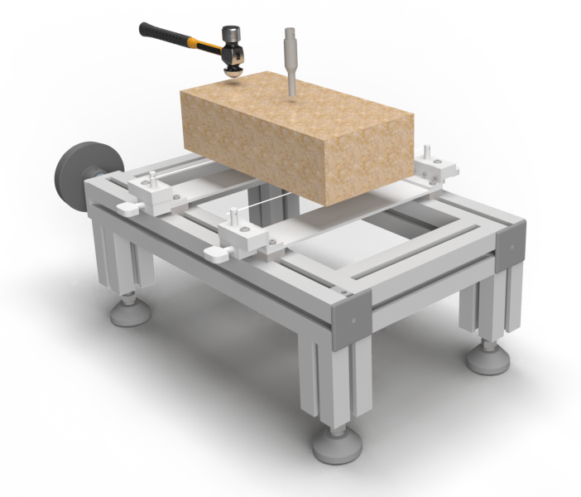
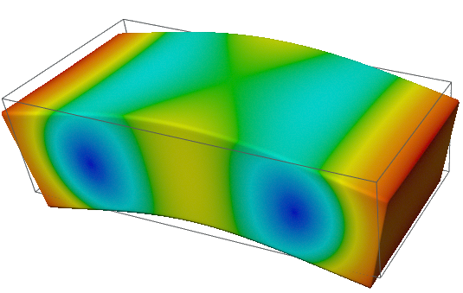
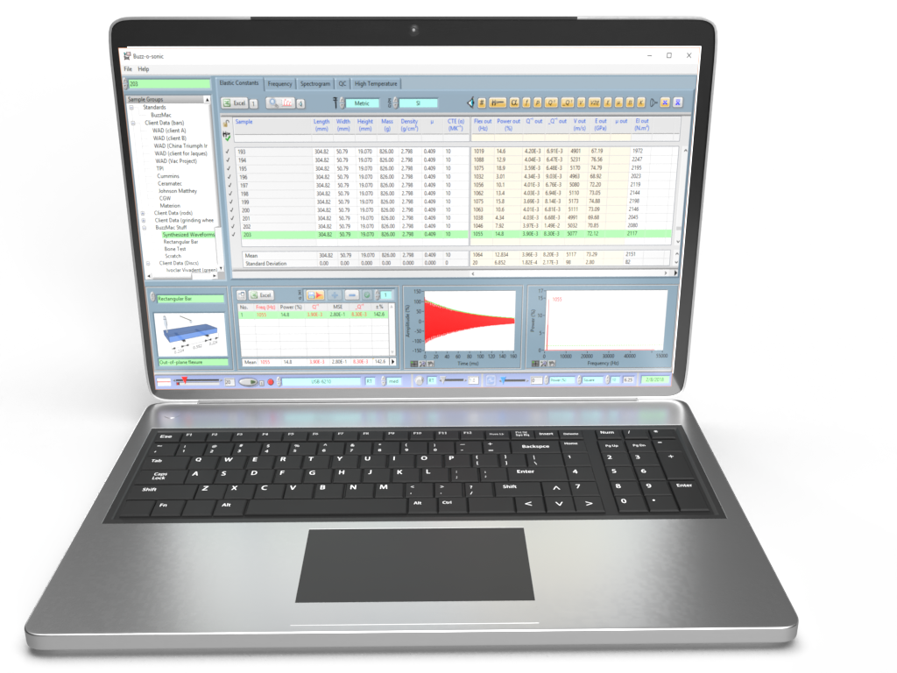
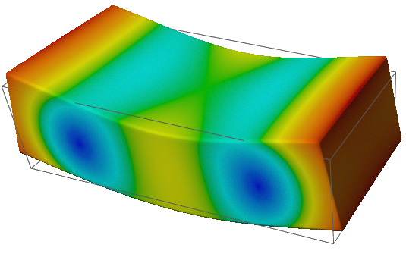
Impulse Excitation Technique (IET)*
TAP
BRICK
MEASURE
VIBRATIONS
RECORD & ANALYSE
(damping/elastic properties)
*also known as ping test, resonant vibration, impact acoustic resonance, eigen frequency method…

Slide 3
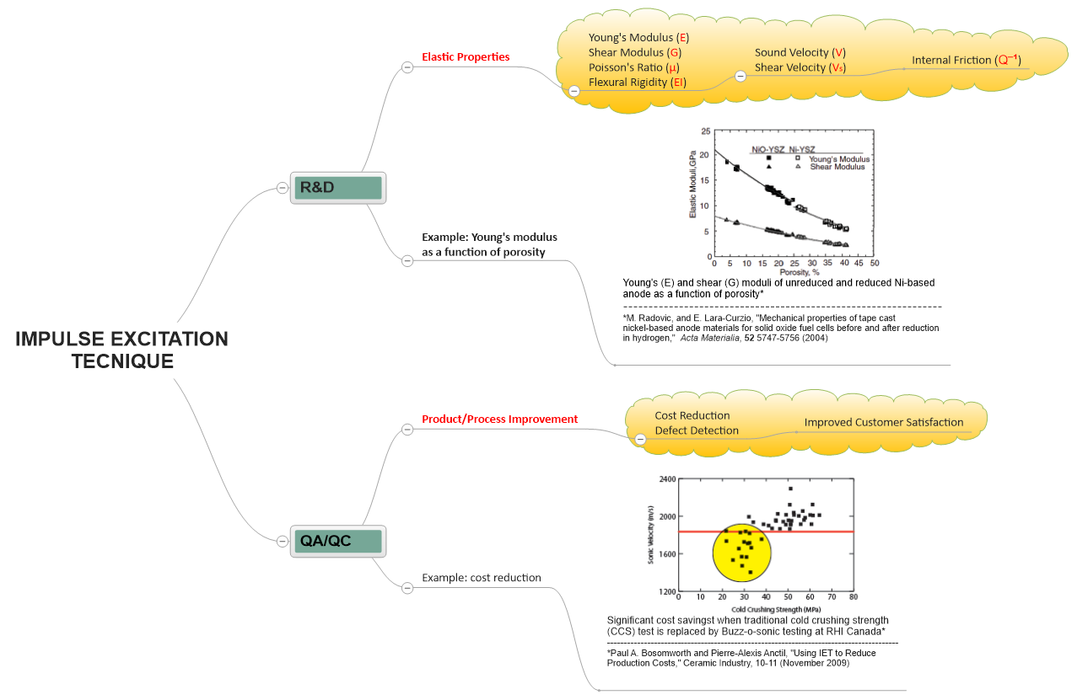
Research
Development
Quality Control
Process Control
Cost Saving
COMPLIES WITH ASTM E1876 & C1259…

Slide 4
Research & Development: Example 1
Thermal Shock Testing of Magnesia Brick
A series of gel-bonded magnesia refractories* were water quenched through temperature differences ΔT. The Young’s modulus (E) was measured afterward using a resonant frequency method similar to IET.
*ethyl silicate (EA1-EA4), tetraisoproplyl titanate (T-T), and a pressed brick (PB)
‘’
A new parameter, R_{st}, was used to quantify the thermal stress damage resistances which correlated to the pore sizes of the refractories¹
¹ Based on Ph.D. Thesis by P.A. Bosomworth, Leeds University, Leeds, UK, 1986

Slide 5
Research & Development: Example 2
Monitoring Elastic Properties During Firing
Green extruded cylinder of a quartz-porcelain mixture fired to 1100°C¹
Unfired (green) ceramics can be tested using IET and the changes in elastic properties monitored during firing.
NOTE: Elastic properties can also be monitored during hydration and other processes because the test is nondestructive
¹ P. A. Bosomworth, " Monitoring the Elastic Properties of Green Ceramics during Firing," Ceramic Industry (February 2016) &
Igor Stubna, Frantisek Chmelık, Anton Trnık, Peter Sin, “Acoustic Emission Study of Quartz Porcelain during Heating up to 1150°C,” Ceram. Int., 38 6919–6922 (2012)

Slide 6
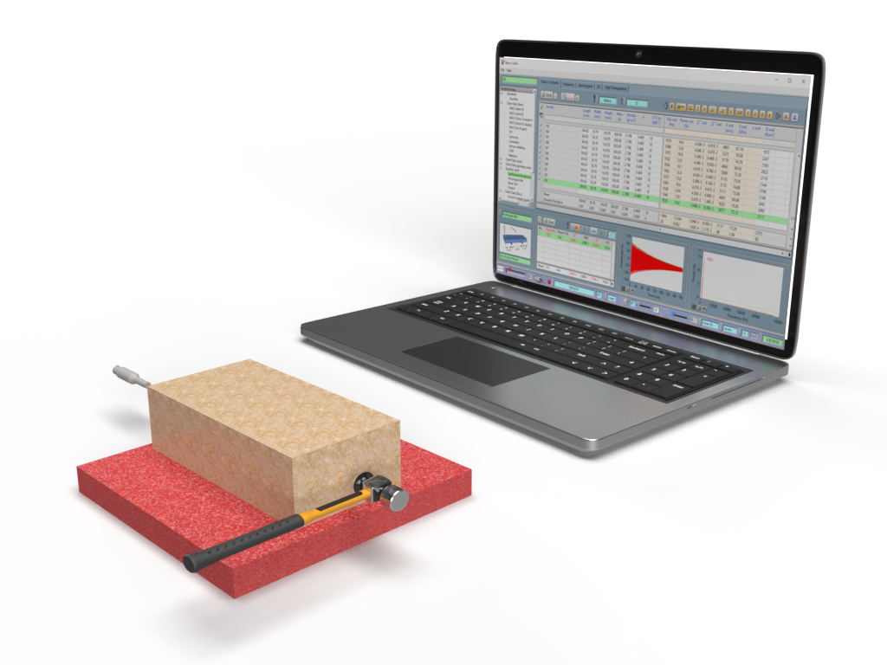
Quality Control
Reducing Production Costs of Magnesite-Chrome Brick¹
Sonic velocity = 2 x length x frequency
Low strength population that we want to identify
Cold crushing strength testing is a much slower and therefore a more expensive test than sonic velocity testing using IET
¹ Paul A. Bosomworth and Pierre-Alexis Anctil, "Using IET to Reduce Production Costs," Ceramic Industry, 10-11 (November 2009)

Slide 7
Conclusions and Comments
IET is ideally suited to measuring the elastic and damping properties of refractories
IET can be used over a variety of testing environments (high/low temperatures, humidity…)
IET is fast, efficient and relatively low cost compared to destructive mechanical testing
IET is suited to R&D, QC/QA, cost reduction…
Any question or comments, please contact me on linkedin.com/in/paul-bosomworth-78151514

